Slide 1
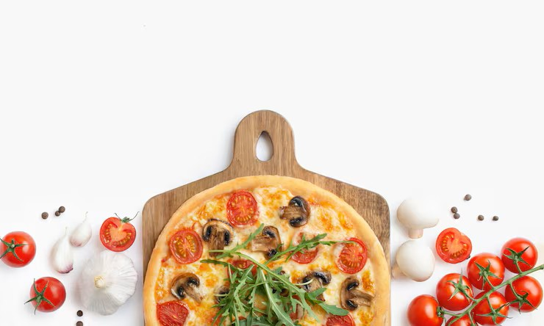
PIZZA SALES ANALYSIS USING SQL

Slide 2
PROJECT OVERVIEW :
This project focuses on the analysis of pizza sales data to gain insights into customer preferences, revenue generation, and order patterns.
The dataset used in this analysis contains information about pizza sales during the year 2015. This project analyzes a pizza sales dataset using SQL queries.
By examining the data, my aim is to uncover valuable insights that can help inform business decisions and optimize the pizza sales operations.
Tools & Technologies Used :
MySQL
SQL Server Management Studio (SSMS)

Slide 3
OBJECTIVES :
Analyze total revenue generated from pizza sales
Identify the most popular pizzas
Understand sales distribution by pizza category and size
Analyze monthly order trends
Identify top revenue-generating pizzas
BUSINESS POTENTIAL :
Understanding customer preferences and market trends is crucial for businesses to thrive in a competitive environment. Analyzing sales data allows us to gain a deeper understanding of customer behavior, identify popular pizza choices, and recognize patterns in customer orders.

Slide 4
DATASET DESCRIPTION:
Column Name | Description
pizza_id | Unique identifier for each pizza record
order_id | Unique identifier for each order
pizza_name_id | Identifier for pizza type
quantity | Number of pizzas ordered
order_date | Date when the order was placed
order_time | Time when the order was placed
unit_price | Price of one pizza
total_price | Total price for the order
pizza_size | Size of pizza (S, M, L, XL, XXL)
pizza_category | Category of pizza (Classic, Chicken, Veggie, Supreme)
pizza_ingredients | Ingredients used
pizza_name | Name of the pizza

Slide 5
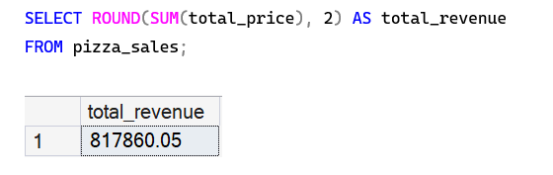
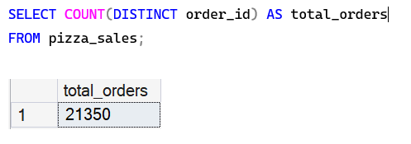
BASIC QUERIES:
What is the total revenue generated from all pizza sales?
2. How many total distinct orders were placed?

Slide 6
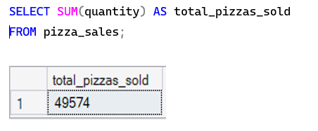
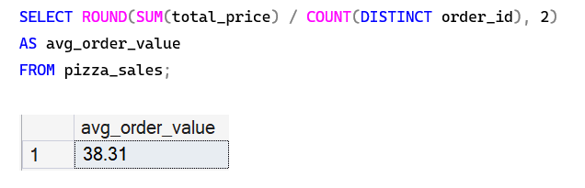
3. What is the total number of pizzas sold?
4. What is the average order value of all pizzas?

Slide 7
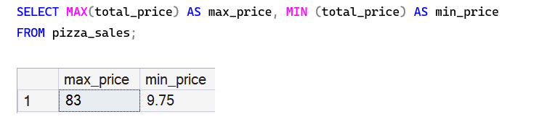
5. What is the max and min order value?

Slide 8
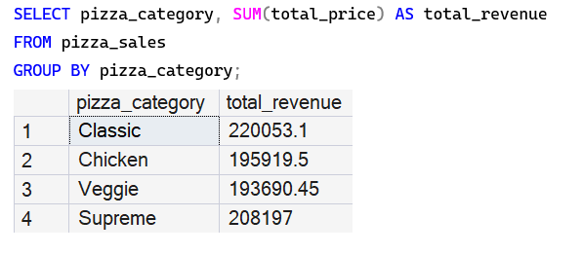
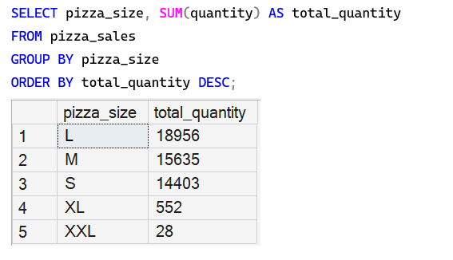
INTERMEDIATE QUERIES:
6. What is the total revenue generated by each pizza category?
7. What is the total quantity sold for each pizza size ordered descending?

Slide 9
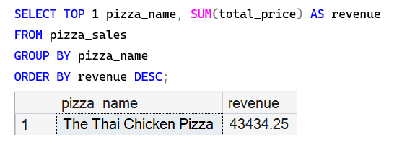
8. Which pizza generated the highest revenue?

Slide 10
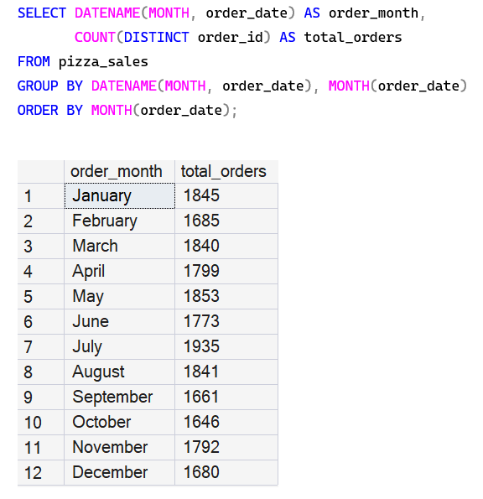
9. What is the total numbers of orders placed per month?

Slide 11
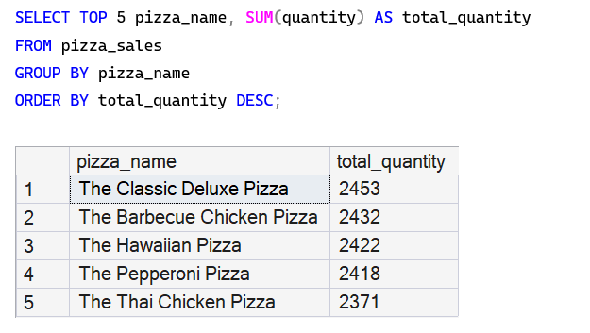
10. What are the top 5 best-selling pizzas based on quantity sold?

Slide 12
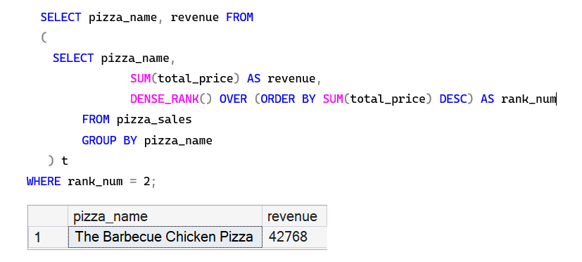
ADVANCED QUERIES:
11. Find the second highest revenue-generating pizza using a subquery or window function

Slide 13
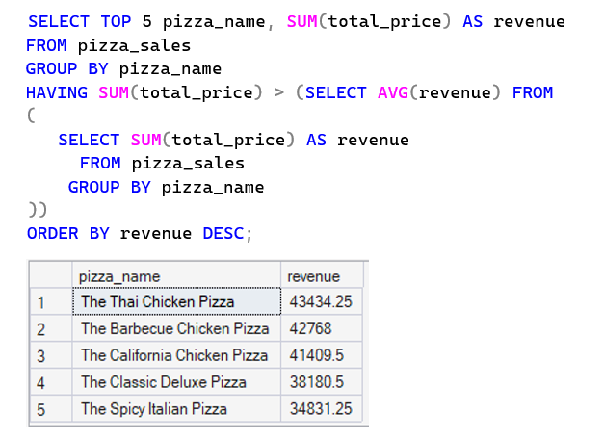
12. Which top 5 pizzas generate revenue higher than the average pizza revenue?

Slide 14
INSIGHTS:
The business generated $817,860.05 in total revenue from 21,350 orders, indicating strong overall sales performance.
A total of 49,574 pizzas were sold, showing high customer demand for pizza products.
Classic pizzas generated the highest revenue, making them the most profitable category.
Large pizzas are the most popular size, with the highest quantity sold among all sizes.
The Thai Chicken Pizza and Barbecue Chicken Pizza are among the top revenue-generating pizzas.

Slide 15
RECOMMENDATIONS:
Promote top-performing pizzas such as Thai Chicken and Barbecue Chicken pizzas to increase sales.
Introduce combo offers on large pizzas, as they are the most preferred size.
Run seasonal promotions during low-demand months to maintain consistent sales.
Expand the Classic pizza category with new flavors since it generates the highest revenue.
Use sales insights to create data-driven marketing strategies and improve menu planning.

Slide 16
CONCLUSION:
The SQL analysis of the pizza sales dataset provided valuable insights into revenue performance, customer preferences, and product demand. The business generated strong revenue with a high number of orders and pizzas sold throughout the year.
The analysis highlighted that Classic pizzas and large pizza sizes contribute significantly to sales, while certain pizzas such as Thai Chicken and Barbecue Chicken play a major role in driving revenue.
These insights can help the business make data-driven decisions, improve marketing strategies, and optimize menu offerings to enhance overall sales performance and customer satisfaction.

Slide 17
THANK YOU

